Slide 1
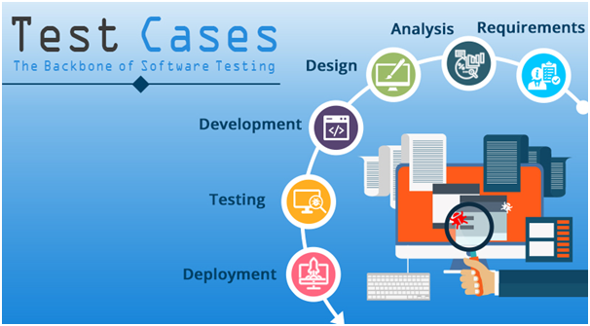
Test cases -
Creation & Execution using Test Management Tool
Arif Gajula
June, 2020

Slide 2
Objective
To help trainees get some familiarity with test management tools and practices to be adhered. This includes writing test cases & executing in a test case management tool.

Slide 3
Test Cases

Slide 4
What is a Test Case ? What is a Test Scenario ?

Slide 5
Types of test cases
Functional tests
To test if the application works with the rest of the system and its users. The tests reveal that the software has succeeded or failed to perform the functions
UI Tests
to check the GUI according to client requirements. GUI Testing involves the width of the buttons and the fields in which all text, tables, and columns are aligned in the display.
End-to-End tests
To test the complete workflow of the application
and many more..

Slide 6
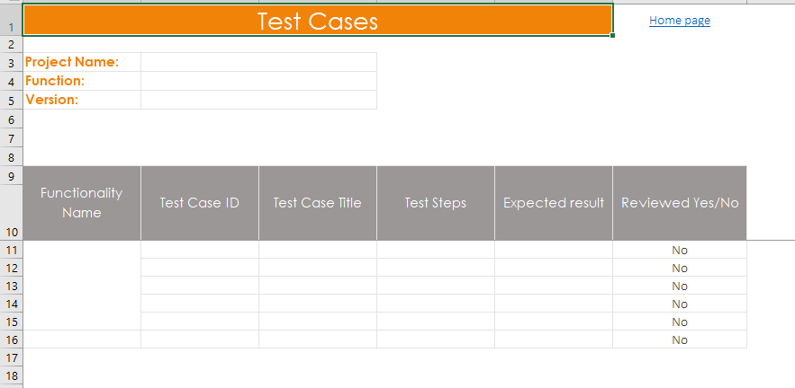
Template - Test Cases

Slide 7
Test Data

Slide 8
What is test data?
Test data is the data which is identified to test the software. It ensures complete testing coverage, thereby improving the quality.

Slide 9
Test Data Criteria
No data
Valid data
Invalid data
Boundary Condition Data set

Slide 10
Test Data Generation Tips
Create before test case execution
Complete – to cover Positive & Negative scenarios
Regular updates
Use automation tool to create huge amount of test data
Take developer’s help

Slide 11
Test Environments

Slide 12
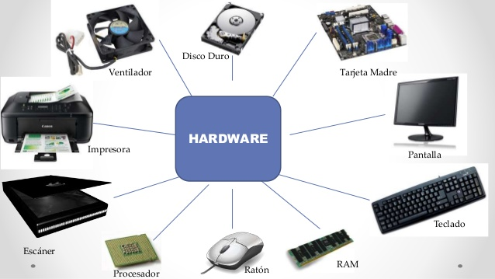



Test Environments
Hardware
Software
Network

Slide 13
Test Execution

Slide 14
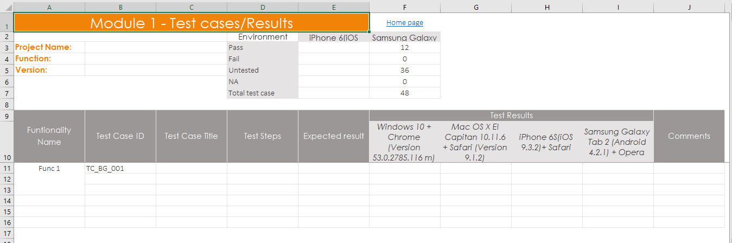
Template - Test results by Module

Slide 15
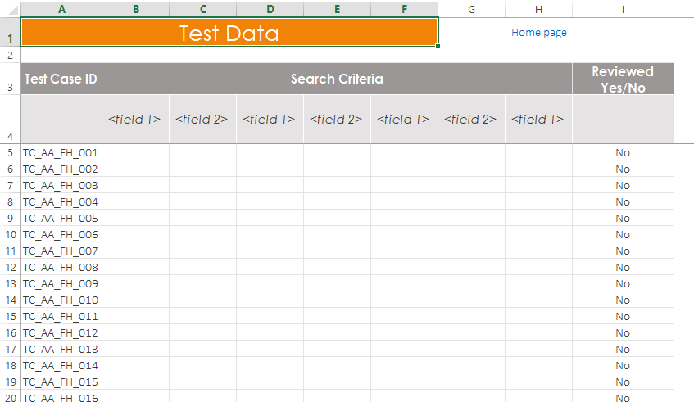
Template - Test data for test cases

Slide 16
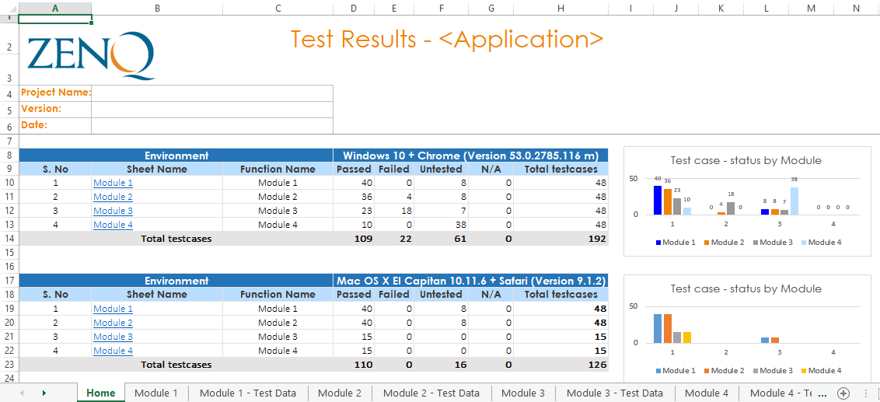
Template - Test results summary

Slide 17
Test Results
Not Run
Blocked/On Hold
Pass
Fail

Slide 18
Test Link & its usage

Slide 19
Writing & Reviewing test cases
Sample application - https://opensource-demo.orangehrmlive.com/index.php/auth/login

Slide 20
Using Test Link
Creating Sample Test cases
Creating Sample test plan
Execute Sample Test cases
Sample Reports
http://apps.zenq.com:8081/testlink

Slide 21
Thank You!

